Slide 1
HISTORIC YEAR 2019-2023 AND FORECAST TO 2032
ANTIMICROBIAL TEXTILE MARKET
By Active Agent: Synthetic Organic Compounds, Metal & Metallic Salts, Bio-based / Natural Agents, Others By Fabric Type: Cotton, Polyester, Polyamide, Blended / Composite Fabrics, Others By Distribution Channel: Offline (B2B, Direct sales, Distributors), Online (B2B, Direct sales, Distributors) By Application: Medical Textiles, Apparel & Sportswear, Home Textiles, Commercial Textiles, Industrial Textiles, Other By End-User: Healthcare Sector, Consumer, Industrial, Defense & Military, Others By Region: North America, Europe, Asia-Pacific, Latin America, Middle East & Africa

Slide 2
MARKET SEGMENTATION
ANTIMICROBIAL TEXTILE MARKET (USD BILLION)
YEARS CONSIDERED :
Historical Year - 2019-2023 | Base Year - 2024 | Forecast Year - 2025-2032
BY ACTIVE AGENT
BY FABRIC TYPE
BY DISTRIBUTION CHANNEL
BY APPLICATION
BY END-USER
Synthetic Organic Compounds
Metal & Metallic Salts
Bio-based / Natural Agents
Others
Cotton
Polyester
Polyamide
Blended / Composite Fabrics
Others
Offline
Online
Medical Textiles
Apparel & Sportswear
Home Textiles
Commercial Textiles
Industrial Textiles
Other
Healthcare Sector
Consumer
Industrial
Defense & Military
Others

Slide 3

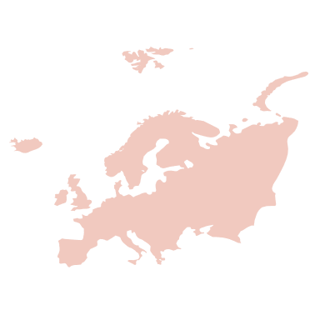
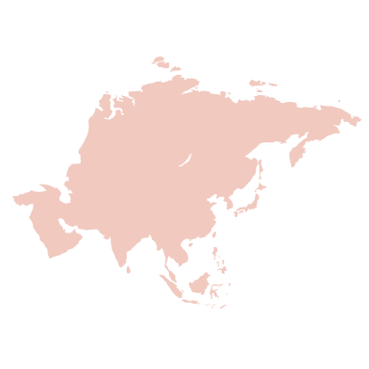

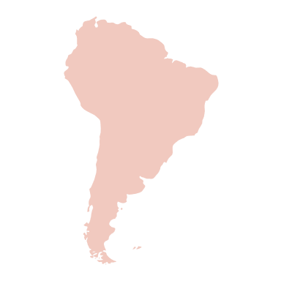

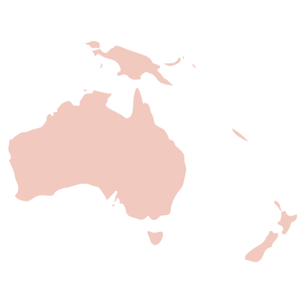

MARKET TAXONOMY
ANTIMICROBIAL TEXTILE MARKET (USD BILLION)
YEARS CONSIDERED :
Historical Year - 2019-2023 | Base Year - 2024 | Forecast Year - 2025-2032
NORTH AMERICA
EUROPE
ASIA PACIFIC
LATIN AMERICA
MIDDLE EAST & AFRICA
Mexico
GCC Countries
United Kingdom
China
Brazil
Canada
Germany
France
Japan
Spain
South Korea
United States
Italy
India
South Africa
United Kingdom
Germany
France
Spain
GCC Countries
South Africa
Rest of MEA
Italy
Rest of Europe
China
Japan
India
Brazil
Mexico
Rest of LATAM
United States
Canada
South Korea
Rest of APAC

Slide 4
TABLE OF CONTENTS-
ANTIMICROBIAL TEXTILE MARKET-
HISTORIC YEAR 2019-2023 FORECAST TO 2032

Slide 5

TABLE OF CONTENTS
1. Introduction | 4.5. Demand Side Trends
1.1. Objectives of the Study | 4.6. Porter's Analysis & Impact
1.2. Market Definition & Scope | 4.6.1. Competitive Rivalry
2. Research Methodology | 4.6.2. Threat of substitutes
2.1. Research Process | 4.6.3. Bargaining power of buyers
2.2. Secondary & Primary Data Methods | 4.6.4. Threat of new entrants
2.3. Market Size Estimation Methods | 4.6.5. Bargaining power of suppliers
2.4. Market Assumptions & Limitations | 5. Key Market Insights
3. Executive Summary | 5.1. Key Success Factors
3.1. Global Market Outlook | 5.2. Market Impacting Factors
3.2. Key Market Highlights | 5.3. Top Investment Pockets
3.3. Segmental Overview | 5.4. Market Attractiveness Index, 2024
4. Market Dynamics & Outlook | 5.5. Market Ecosystem
4.1. Macro-Economic Indicators​ | 5.6. PESTEL Analysis
4.2. Drivers & Opportunitiess | 5.7. Pricing Analysis
4.3. Restraints & Challenges | 5.8. Regulatory Landscape
4.4. Supply Side Trends | 5.9. Case Studies

Slide 6
TABLE OF CONTENTS
5.10. Technological Analysis | 7.5. Others
5.11. Patent Analysis | 8. Antimicrobial Textile Market Size by Distribution Channel (2019-2032)
5.12. Startup Analysis | 8.1. Offline
5.13. Value Chain Analysis | 8.1.1. B2B
5.14. Supply Chain Analysis | 8.1.2. Direct sales
5.15. Customer & Buying Criteria Analysis | 8.1.3. Distributors
5.16. Raw Material Analysis | 8.2. Online
6. Antimicrobial Textile Market Size by Active Agent (2019-2032) | 8.2.1. B2B
6.1. Synthetic Organic Compounds | 8.2.2. Direct sales
6.2. Metal & Metallic Salts | 8.2.3. Distributors
6.3. Bio-based / Natural Agents | 9. Antimicrobial Textile Market Size by Application (2019-2032)
6.4. Others | 9.1. Medical Textiles
7. Antimicrobial Textile Market Size by Fabric Type (2019-2032) | 9.2. Apparel & Sportswear
7.1. Cotton | 9.3. Home Textiles
7.2. Polyester | 9.4. Commercial Textiles
7.3. Polyamide | 9.5. Industrial Textiles
7.4. Blended / Composite Fabrics | 9.6. Other

Slide 7
10. Antimicrobial Textile Market Size by End-User (2019-2032) | 11.3. Asia-Pacific (By Active Agent, By Fabric Type, By Distribution Channel, By Application, By End-User)
10.1. Healthcare Sector | 11.3.1. China
10.2. Consumer | 11.3.2. India
10.3. Industrial | 11.3.3. Japan
10.4. Defense & Military | 11.3.4. South Korea
10.5. Others | 11.3.5. Rest of Asia Pacific
11. Antimicrobial Textile Market Size by Region (2019-2032) | 11.4. Latin America (By Active Agent, By Fabric Type, By Distribution Channel, By Application, By End-User)
11.1. North America (By Active Agent, By Fabric Type, By Distribution Channel, By Application, By End-User) | 11.4.1. Brazil
11.1.1. US | 11.4.2. Mexico
11.1.2. Canada | 11.4.3. Rest of Latin America
11.2. Europe (By Active Agent, By Fabric Type, By Distribution Channel, By Application, By End-User) | 11.5. Middle East & Africa (By Active Agent, By Fabric Type, By Distribution Channel, By Application, By End-User)
11.2.1. UK | 11.5.1. GCC Countries
11.2.2. Germany | 11.5.2. South Africa
11.2.3. Spain | 11.5.3. Rest of Middle East & Africa
11.2.4. France | 12. Competitive Lapscape
11.2.5. Italy | 12.1. Competitive Dashboard
11.2.6. Rest of Europe | 12.2. Market Positioning of Key Players, 2024
TABLE OF CONTENTS

Slide 8
12.3. Strategies Adopted by Key Market Players | 13.9. Sanitized AG
12.4. Recent Developments in the Market | 13.10. Toyobo Co. Ltd.
12.5. Company Market Share Analysis, 2024 | 13.11. Unitika Ltd.
13. Key Company Profiles | 13.12. Indorama Ventures Public Co. Ltd.
13.1. Milliken & Company | 13.13. Kolon Industries, Inc.
13.1.1. Company Overview | 13.14. LifeThreads LLC
13.1.2. Product Portfolio Overview | 13.15. Sarex Textile Chemicals
13.1.3. Financial Overview | 13.16. Vardhman Holdings Limited
13.1.4. Key Developments | 13.17. BioCote Limited
The following companies are listed for indicative purposes only. Similar information will be provided for each, with detailed financial data available exclusively for publicly listed companies. | 13.18. Microban International Ltd.
13.2. PurThread Technologies, Inc. | 13.19. HeiQ Materials AG
13.3. Trevira GmbH | 13.20. Noble Biomaterials, Inc.
13.4. Thai Acrylic Fibre Co. Ltd. | Note : The list of companies mentioned are for indication purpose and are subject to change over the due course of the research
13.5. Vestagen Protective Technologies, Inc. | 14. Conclusion & Recommendation
13.6. Herculite Products, Inc.
13.7. BASF SE
13.8. Dow (The Dow Chemical Company)
TABLE OF CONTENTS

Slide 9
RESEARCH METHODOLOGY
Research Process
Secondary & Primary Data Methods
Market Size Estimation Methods
Market Assumptions & Limitations
ANTIMICROBIAL TEXTILE MARKET -
HISTORIC YEAR 2019-2023 FORECAST TO 2032

Slide 10
RESEARCH METHODOLOGY
Research Objective
The process begins with clearly defining the research objective, which serves as the foundation for the study. This step identifies the specific goals, questions, or problems the research aims to address.
Research Objective
Secondary Research
Secondary research involves collecting existing data from credible sources to build a comprehensive baseline. This stage gathers relevant insights to contextualize the study and identify data gaps.
Data Modelling
Secondary Research
Data Analysis
Primary Research
Primary Research
Primary research directly gathers first-hand data to validate, complement, or update insights obtained during secondary research. It involves interacting with industry stakeholders to provide real-time insights and market perspectives.
Data Modelling
This step involves using data modeling techniques to forecast future trends and market behavior. Predictive modeling ensures informed decision-making by aligning results with economic, industry, and population metrics.
Data Analysis
Data collected through secondary and primary research is rigorously analyzed to uncover patterns, trends, and actionable insights. This step ensures that findings are relevant, consistent, and aligned with the research objectives
Data Reporting
The findings and insights are compiled into a detailed, well-structured report that aligns with the client's needs and objectives. The report provides actionable recommendations and data-driven conclusions.
Data Reporting

Slide 11

SECONDARY RESEARCH
The purpose of secondary research is to build a solid foundation for understanding the target market by leveraging existing data, reports, and publications. This step is essential to gaining an initial perspective on the market size, trends, competitive dynamics, challenges, and opportunities. Secondary research helps map out broad market insights that can guide further exploration and refinement of the research focus.
Analyst's Role:
Source information from industry reports, government data, trade publications, and online repositories.
Map out the competitive landscape, market challenges, and emerging opportunities.
Highlight data gaps and refine the focus for primary research.
Data Sources
Association and Organization | Research Paper and Journal | Competition Data | Paid Databases | SkyQuest Internal Database
American Association of Textile Chemists and Colorists (AATCC) | Textile Research Journal | Annual Report | Factiva
ASTM International | Journal of Industrial Textiles | Investor Presentation | Bloomberg
International Organization for Standardization (ISO) | Journal of Applied Polymer Science | SEC Filling/ 10K Sizes | Hoovers
U.S. Environmental Protection Agency (EPA) | Surface and Coatings Technology | Company Website | Morningstar
European Chemicals Agency (ECHA) | Colloids and Surfaces B: Biointerfaces | Trade Data | Seeking Alpha

Slide 12
PRIMARY RESEARCH
The purpose of executing primary research is to gather firsthand insights that validate and complement the data gathered during secondary research. By directly engaging with market participants, primary research ensures that the findings are grounded in real-world market dynamics. This step provides fresh, up-to-date, and specific information that is essential to gain a more nuanced understanding of the market, uncovering insights that secondary sources may not capture.
Analyst's Role:
Develop interview guides and surveys tailored to the study's objectives
Engage with key industry stakeholders, such as business leaders, end-users, and experts.
Capture a blend of qualitative and quantitative data, ensuring diversity in perspectives.
Break up of Primary Interviews with Industry Experts
BY COMPANY
BY DESIGNATION
BY REGION

Slide 13
EXECUTIVE SUMMARY
ANTIMICROBIAL TEXTILE MARKET -
HISTORIC YEAR 2019-2023 AND FORECAST TO 2032

Slide 14
EXECUTIVE SUMMARY
MARKET OUTLOOK
FIGURE 01. ANTIMICROBIAL TEXTILE MARKET SIZE, (USD BILLION)
The Antimicrobial Textile Market is valued at USD 13.6 Billion in 2024, and is expected to reach USD 22.9 Billion by 2032. The market shows a steady CAGR of 7.7% from 2025 to 2032. Rising hygiene awareness, stricter infection-control protocols and demand from healthcare, hospitality and activewear are driving adoption of antimicrobial textiles worldwide. Innovation in durable, low-toxicity treatments — from silver and copper-based finishes to bio-based agents (chitosan, plant extracts), plus smart-textile integration — is expanding applications. Market dynamics favor collaboration between specialty finishers (Sanitized, Microban, HeiQ), chemical majors (BASF, DuPont, Clariant) and textile manufacturers to deliver certified, regulatory-compliant solutions. Sustainability, regulatory scrutiny of traditional biocides and customization for end-use performance will shape consolidation, green-chemistry adoption and steady growth in medical, consumer and industrial segments.
Key Market Enablers
22.9
Healthcare-driven demand: Rapid expansion of healthcare infrastructure, aging populations, and infection control priorities are driving strong adoption of antimicrobial textiles in medical garments, bedding, and hospital upholstery. Hospitals and long-term care facilities prioritize materials that reduce pathogen transmission, lower infection rates, and decrease laundering frequency. This demand is bolstered by clinical studies demonstrating efficacy and procurement policies favoring antimicrobial solutions, creating sustained market pull and opportunities for manufacturers to innovate durable, safe, and cost-effective antimicrobial textile products with scalable production. Regulatory and consumer drivers: Strengthening government regulations, voluntary standards, and hospital procurement guidelines are encouraging certification and adoption of antimicrobial textiles, while rising consumer awareness of hygiene and desire for durable, odor-resistant apparel and home textiles fuels retail demand. Sustainability expectations push manufacturers toward safer, non-toxic biocides and eco-friendly processing, prompting investment in compliant chemistries and transparent labeling. Combined regulatory clarity and informed consumers accelerate market acceptance, premium product positioning, and partnerships across supply chains to scale production and distribution.
13.6

Slide 15


EXECUTIVE SUMMARY
TOP-10 COUNTRY ASSESSMENT, 2024 (%)
ANTIMICROBIAL TEXTILE MARKET
SEGMENTAL OVERVIEW, 2024 (%)
ANTIMICROBIAL TEXTILE MARKET
USD 13.6 BILLION

Slide 16
MARKET DYNAMICS & OUTLOOK
Macro-Economic Indicators
Drivers & Opportunities
Restraints & Challenges
Supply Side Trends
Demand Side Trends
Porters Analysis & Impact
Threat of New Entrants
Bargaining Power of Suppliers
Bargaining Power of Buyers
Threat of Substitute
Intensity of Competitive Rivalry
ANTIMICROBIAL TEXTILE MARKET -
HISTORIC YEAR 2019-2023 FORECAST TO 2032

Slide 17


MARKET DYNAMICS & OUTLOOK
SUPPLY SIDE TRENDS
DEMAND SIDE TRENDS

Slide 18
MARKET DYNAMICS & OUTLOOK : MARKET DRIVERS & OPPORTUNITIES (1/X)
Escalating concern about healthcare-associated infections has driven hospitals and clinics to adopt antimicrobial textiles for linens, scrubs, curtains, and wound-care dressings, aiming to enhance infection prevention protocols. Facilities deploy silver-infused bedding, copper-treated surfaces, and antimicrobial barrier fabrics to reduce microbial burden in high-contact zones, aligning with clinical hygiene initiatives and accreditation expectations. Real-world adoption is evident in hospital linen programs and surgical drape specifications, where textile performance is evaluated alongside sterilization and cleaning practices to support patient safety efforts. Systems Consumer demand for odor control and fabric freshness has pushed apparel and home-textile makers to integrate antimicrobial treatments, enhancing comfort and lifespan. Sportswear and activewear utilize silver ion or surface treatments to inhibit odor-causing bacteria, while mattress and towel producers promote antimicrobial finishes for hygiene. Hospitality and airline operators similarly specify treated linens and seat covers to improve guest perception and turnaround. These adoption patterns reflect real pressure from consumers and service providers for textiles that better withstand microbial challenges. Regulatory scrutiny and procurement requirements compel textile manufacturers to substantiate antimicrobial claims with durability, safety, and efficacy data, influencing product development and testing regimes. Agencies and certification bodies demand clear evidence about wash-fastness, biocompatibility, and environmental impact, prompting adoption of standardized testing and third-party certification in hospital, institutional, and consumer procurement. For example, healthcare tenders prioritize treated fabrics with validated performance, while certification schemes for textiles and eco-labels shape corporate sourcing decisions and supplier innovation across the industry. globally recognized Technological innovation, including novel antimicrobial chemistries and sustainable biobased solutions, is a critical driver as manufacturers seek effective, low-impact treatments compatible with circular textile strategies. Developments such as chitosan-based finishes, copper-infused yarns, and encapsulated silver technologies aim to balance efficacy, wash durability, and environmental profile, encouraging collaborations between fiber producers, chemical formulators, and apparel brands. Pilot programs in institutional laundries and product launches by apparel and home-textile companies demonstrate industry momentum toward safer, longer-lasting antimicrobial textiles tailored to end-use requirements.
Rising Healthcare and Hygiene Demand Driving Antimicrobial Textile Adoption
*Please note that market drivers & opportunities only for representation view . Our details analysis will be covered in the Final Report.

Slide 19
MARKET DYNAMICS & OUTLOOK : MARKET DRIVERS & OPPORTUNITIES (2/X)
Integration of antimicrobial treatments into smart textiles preserves sensor accuracy and prolongs wearable functionality by preventing biofouling and microbial degradation of conductive pathways. Smart bandages, textile electrodes for ECG monitoring, and performance wearables rely on clean textile surfaces to maintain signal fidelity. Academic and industry studies demonstrate that microbial films can alter surface impedance and obstruct sensors. As more garments embed biosensors and electronics, antimicrobial finishes become essential to protect device operation and ensure reliable data capture in real-world conditions. Developers adapt antimicrobial chemistries and textile construction to be electrically compatible with embedded sensors, using metallic agents like copper and silver, antimicrobial peptides, and plasma surface treatments that preserve conductivity. Manufacturers and startups produce conductive yarns and coated fabrics engineered for wash durability while retaining antimicrobial activity. These solutions are applied in garments and electrode interfaces to reduce contact impedance changes and sensor drift. Successful integration balances antimicrobial efficacy with preservation of electronic pathways, mechanical flexibility, and wearer comfort requirements. Antimicrobial textiles are increasingly critical for mission-critical wearable systems where sensor reliability under harsh conditions matters. Space agencies and defense research assess antimicrobial materials to protect sensors during long-duration missions and field deployments, reducing maintenance burdens. In sports science and occupational safety, embedded physiological monitors and environmental sensors rely on antimicrobial-treated electrodes and overlays to sustain performance during sweat, dirt exposure, and use. This cross-sector demand pushes innovation in robust antimicrobial conductive textiles designed for extreme environments and sustained functionality. Standardization and testing regimes drive adoption of antimicrobial textiles in sensor-integrated garments by establishing benchmarks for durability, antimicrobial efficacy, and electrical stability. Stakeholders use textile standards and antimicrobial test methods to validate claims, while medical device pathways demand biocompatibility and safety data when textiles contact skin or wounds. Labs and certification bodies evaluate wash-fastness, impedance changes, and sustained antimicrobial activity under simulated use. Clear protocols increase purchaser confidence across healthcare, defense, and wearable technology firms seeking verified multifunctional textiles solutions.
Preserving Sensor Performance in Smart and Wearable Textiles

Slide 20
MARKET DYNAMICS & OUTLOOK : MARKET RESTRAINTS & CHALLENGES
Regulatory fragmentation and evolving safety frameworks pose adoption barriers for antimicrobial textiles. Agencies such as the US EPA, the European Biocidal Products Regulation, and healthcare regulators apply different criteria for treated articles, medical devices, and biocides, complicating claims and approvals. For example, textiles incorporating silver nanoparticles often face additional toxicological evaluation and labeling requirements, while medical-grade antimicrobial fabrics may require device-level clearance, slowing product launches and increasing compliance complexity for manufacturers navigating multiple jurisdictions, and raising consumer trust and liabilities. Environmental toxicity and persistence of antimicrobial agents constrain product development and acceptance. Treatments such as silver nanoparticles and certain biocides can leach from fabrics during laundering, entering wastewater systems and affecting aquatic organisms and microbial communities. Research has documented accumulation of metallic antimicrobials in sewage sludge and impacts on wastewater treatment efficacy, prompting scrutiny from environmental agencies. Consumer concerns about long-term ecological harm and calls for greener alternatives drive manufacturers to seek safer chemistries and improved leaching mitigation strategies globally. Scientific and public health concerns about promoting antimicrobial resistance challenge widespread adoption of treated textiles. Sublethal exposures from degraded treatments or incomplete microbial kill can select for tolerant strains, and researchers have reported responses to agents like triclosan and metals in isolates. Health authorities caution that nonclinical applications may contribute to resistance reservoirs outside hospitals, complicating infection control. These risk narratives push buyers toward minimal necessary use, targeted clinical products, and investments in alternative approaches such as physical antimicrobial mechanisms. High development, testing, and compliance costs restrict smaller firms from innovating at scale in antimicrobial textiles. Manufacturers face extensive performance validation, durability testing for repeated laundering, and standardized antimicrobial efficacy assays to substantiate claims during procurement processes. Hospitals and apparel brands increasingly demand independent verification and lifecycle assessments, raising entry barriers. Real-world supply chains confront scalability hurdles when integrating novel chemistries, driving consolidation around established suppliers and slowing the diffusion of innovative, safer alternatives throughout the industry, and raising prices.
Regulatory and safety concerns limiting antimicrobial textile adoption

Slide 21




MARKET OVERVIEW

Slide 22
KEY MARKET INSIGHTS
Key Success Factors Market Impacting Factors Top Investment Pockets Market Attractiveness Index, 2024 Market Ecosystem PESTEL Analysis Pricing Analysis Regulatory Landscape
Case Studies Technological Analysis Patent Analysis Startup Analysis Value Chain Analysis Supply Chain Analysis Customer & Buying Criteria Analysis Raw Material Analysis
ANTIMICROBIAL TEXTILE MARKET-
HISTORIC YEAR 2019-2023 FORECAST TO 2032

Slide 23




KEY MARKET INSIGHTS

Slide 24
GLOBAL MARKET ANALYSIS, SEGMENTAL ANALYSIS
By Active Agent By Fabric Type By Distribution Channel By Application By End-User
ANTIMICROBIAL TEXTILE MARKET-
HISTORIC YEAR 2019-2023 FORECAST TO 2032

Slide 25

GLOBAL MARKET ANALYSIS – BY ACTIVE AGENT
ANTIMICROBIAL TEXTILE MARKET SIZE, BY ACTIVE AGENT, 2019-2032 (USD BILLION)
Key Takeaways
 | 2019 | 2020 | 2021 | 2022 | 2023 | 2024 | 2025 | 2026 | 2027 | 2028 | 2029 | 2030 | 2031 | 2032 | CAGR (2025–2032)
Synthetic Organic Compounds | XX | XX | XX | XX | XX | XX | XX | XX | XX | XX | XX | XX | XX | XX | XX%
Metal & Metallic Salts | XX | XX | XX | XX | XX | XX | XX | XX | XX | XX | XX | XX | XX | XX | XX%
Bio-based / Natural Agents | XX | XX | XX | XX | XX | XX | XX | XX | XX | XX | XX | XX | XX | XX | XX%
Others | XX | XX | XX | XX | XX | XX | XX | XX | XX | XX | XX | XX | XX | XX | XX%
Total | XX | XX | XX | XX | XX | XX | XX | XX | XX | XX | XX | XX | XX | XX | XX%
*Please note that this slide represents an indicative segmentation overview. the complete level-2 segmentation analysis will be covered in the Final Report.

Slide 26
GLOBAL MARKET ANALYSIS BY REGION
ANTIMICROBIAL TEXTILE MARKET-
HISTORIC YEAR 2019-2023 FORECAST TO 2032

Slide 27
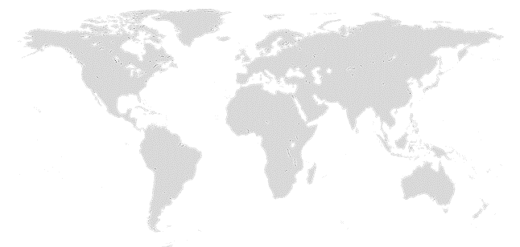

GLOBAL MARKET ANALYSIS BY REGION
ANTIMICROBIAL TEXTILE MARKET: REGIONAL ANALYSIS, 2019-2032 (USD BILLION)
Key Takeaways
Europe
North America secured the foremost market share at 30.4%, and this dominance is projected to persist through the forecast period. This stronghold is attributed to the region's dense concentration of market competitors and an upsurge in cancer incidence rates. Notably, the U.S. witnessed approximately 1,806,590 new cancer diagnoses in 2020, as reported by the National Cancer Institute. The continuous integration of novel technologies, incorporating artificial intelligence, and the frequent launch of low-radiation CT scans are anticipated to further contribute to the region's market growth.
Conversely, Asia Pacific is poised for noteworthy growth, projected to experience a substantial Compound Annual Growth Rate (CAGR) over the forecast period. This surge can be attributed to the ongoing development of healthcare infrastructure, particularly in burgeoning economies such as India and China. The region's high adoption rate of advanced medical imaging devices, coupled with the increasing prevalence of chronic disorders, further fuels market expansion. Notably, local manufacturers in the region are gaining prominence, bolstering market growth.
North America
APAC
MEA
Latin America
Region | 2019 | 2020 | 2021 | 2022 | 2023 | 2024 | 2025 | 2026 | 2027 | 2028 | 2029 | 2030 | 2031 | 2032 | CAGR (2025-2032)
North America | XX | XX | XX | XX | XX | XX | XX | XX | XX | XX | XX | XX | XX | XX | XX%
Europe | XX | XX | XX | XX | XX | XX | XX | XX | XX | XX | XX | XX | XX | XX | XX%
Asia-Pacific | XX | XX | XX | XX | XX | XX | XX | XX | XX | XX | XX | XX | XX | XX | XX%
Latin America | XX | XX | XX | XX | XX | XX | XX | XX | XX | XX | XX | XX | XX | XX | XX%
Middle East & Africa | XX | XX | XX | XX | XX | XX | XX | XX | XX | XX | XX | XX | XX | XX | XX%
Total | XX | XX | XX | XX | XX | XX | XX | XX | XX | XX | XX | XX | XX | XX | XX%

Slide 28
NORTH AMERICA MARKET ANALYSIS – BY ACTIVE AGENT
NORTH AMERICA ANTIMICROBIAL TEXTILE MARKET SIZE, BY ACTIVE AGENT, 2019-2032 (USD BILLION)
 | 2019 | 2020 | 2021 | 2022 | 2023 | 2024 | 2025 | 2026 | 2027 | 2028 | 2029 | 2030 | 2031 | 2032 | CAGR (2025–2032)
Synthetic Organic Compounds | XX | XX | XX | XX | XX | XX | XX | XX | XX | XX | XX | XX | XX | XX | XX%
Metal & Metallic Salts | XX | XX | XX | XX | XX | XX | XX | XX | XX | XX | XX | XX | XX | XX | XX%
Bio-based / Natural Agents | XX | XX | XX | XX | XX | XX | XX | XX | XX | XX | XX | XX | XX | XX | XX%
Others | XX | XX | XX | XX | XX | XX | XX | XX | XX | XX | XX | XX | XX | XX | XX%
Total | XX | XX | XX | XX | XX | XX | XX | XX | XX | XX | XX | XX | XX | XX | XX%
Key Takeaways

Slide 29
U.S. MARKET ANALYSIS – BY ACTIVE AGENT
U.S. ANTIMICROBIAL TEXTILE MARKET SIZE, BY ACTIVE AGENT, 2019-2032 (USD BILLION)
 | 2019 | 2020 | 2021 | 2022 | 2023 | 2024 | 2025 | 2026 | 2027 | 2028 | 2029 | 2030 | 2031 | 2032 | CAGR (2025–2032)
Synthetic Organic Compounds | XX | XX | XX | XX | XX | XX | XX | XX | XX | XX | XX | XX | XX | XX | XX%
Metal & Metallic Salts | XX | XX | XX | XX | XX | XX | XX | XX | XX | XX | XX | XX | XX | XX | XX%
Bio-based / Natural Agents | XX | XX | XX | XX | XX | XX | XX | XX | XX | XX | XX | XX | XX | XX | XX%
Others | XX | XX | XX | XX | XX | XX | XX | XX | XX | XX | XX | XX | XX | XX | XX%
Total | XX | XX | XX | XX | XX | XX | XX | XX | XX | XX | XX | XX | XX | XX | XX%
Key Takeaways

Slide 30
COMPETITIVE LANDSCAPE Competitive Dashboard Market Positioning of Key Players, 2024 Strategies Adopted By Key Market Players Recent Development Market Share Analysis, 2024
ANTIMICROBIAL TEXTILE MARKET -
HISTORIC YEAR 2019-2023 FORECAST TO 2032

Slide 31




COMPETITIVE LANDSCAPE
The following figure represents the market positioning of Antimicrobial Textile Market players for the year 2024. The market positioning of the leading player is done considering the following points:

Slide 32
COMPETITIVE DASHBOARD
COMPETITORS | Milliken & Company | Company 2 | Company 3 | Company 4 | Company5
Headquarters | United States | - | - | - | -
No of Employees(2024) | 8,000 | - | - | - | -
Revenue (US$) 2024 | 3.0 billion | - | - | - | -
Industry Type | - | - | - | - | -
Geographic Presence | Global | - | - | - | -
Year of Establishment | 1865 | - | - | - | -
Market Position | - | - | - | - | -

Slide 33
COMPANY PROFILES
ANTIMICROBIAL TEXTILE MARKET -
HISTORIC YEAR 2019-2023 FORECAST TO 2032

Slide 34
Milliken & Company - COMPANY OVERVIEW
COMPANY AT A GLANCE
OVERVIEW
Established | 1865
Headquarter | United States
Ownership | Private
Revenue (US$)- 2024 | 3.0 billion
No. of Employees (2024) | 8,000
Website | milliken.com
Milliken & Company engages in antimicrobial textiles through BioSmart, a bleach‑activated finish applied to healthcare apparel, lab coats and privacy curtains to reduce contamination between washes. The textile business also supplies medical barrier fabrics used in PPE and shifted to non‑PFAS finishes across its portfolio. Its approach emphasizes materials‑science R&D, partnerships with healthcare laundries and uniform programs, and compliance with infection‑prevention protocols. In 2024 it continued external validations for ethics and innovation and issued a sustainability report detailing progress on product and emissions goals. A global footprint supports commercialization across North America, Europe and Asia, serving hospitals, distributors and workwear brands.
PRODUCT/SERVICE PORTFOLIO
PRODUCT/SERVICE NAME | PRODUCT/SERVICE DESCRIPTION
BioSmart is a patented, bleach-activated antimicrobial finish engineered for medical textiles. With each laundering in EPA-registered chlorine bleach, it binds chlorine to fibers and delivers on-fabric antimicrobial activity between washes; durability is tested to about 75 industrial cycles. Typical uses include scrubs, lab coats and hospital privacy curtains, and gowns.
{{product))

Slide 35
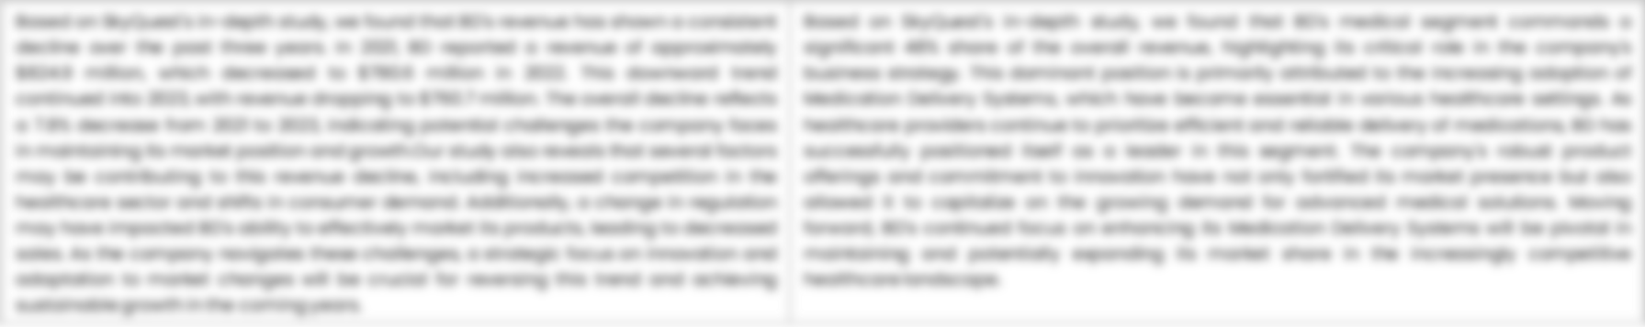
MILLIKEN & COMPANY - FINANCIAL OVERVIEW
MILLIKEN & COMPANY - RECENT FINANCIALS IN USD BILLION (2022-2024) | MILLIKEN & COMPANY - BUSINESS REVENUE MIX, 2024 IN PERCENTAGE (%)
SKYQUEST'S TAKE ON THE COMPANY

Slide 36

MILLIKEN & COMPANY – KEY DEVELOPMENTS
DATE | TYPE OF DEVELOPMENT | DESCRIPTION
October 2023 | Partnership | Microsoft and Siemens are deepening their partnership by bringing the benefits of generative AI to industries worldwide. As a first step, the companies are introducing Siemens Industrial Copilot, an AI-powered jointly developed assistant aimed at improving human-machine collaboration in manufacturing. In addition, the launch of the integration between Siemens Teamcenter software for product lifecycle management and Microsoft Teams will further pave the way to enabling the industrial metaverse.
May 2023 | Product launch | Microsoft Corp. announced a suite of new AI solutions and improvements to Microsoft Clumping Clay for Nonprofit that are designed to transform the nonprofit industry and how fundraisers engage with donors, manage campaigns and optimize operations. In addition, the company announced a limited private preview for nonprofits to experience a new AI-powered fundraising propensity model.

Slide 37
ABOUT US & APPENDIX

Slide 38




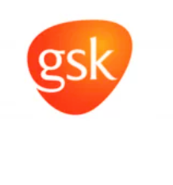






ABOUT US
Established in 2006, SkyQuest is a Global Market Intelligence, Innovation Management organization that connects innovation to new markets, networks & collaborators for achieving sustainable development goals.
SOME OF OUR CLIENTS
180+ Institutional Clients 125000+ Streaming Clients 500+ Workshops Organized
Sectoral Coverage
| Information Technology | Clean Tech | Marketing & Advertising | Water | Life Sciences and Social | Social | Energy and Power | Food & Beverage | Training & E-Learnings & Materials | Semiconductor & Electronics | Oil & Gas | Banking, Financial, Capital Markets, Insurance

Slide 39
OUR CUSTOMIZED RESEARCH CAPABILITIES
CUSTOMER, DISTRIBUTOR, SUPPLIER INTELLIGENCE
TYPE INTELLIGENCE SUPPORT
Identification of potential partners
Shortlisting/finalization of potential partners
Customer need analysis
Customer's purchase and usage behavior
Customer/partner feedback and satisfaction
Brand perception analysis
Import and Export Intelligence
Commodity pricing intelligence
Product pricing intelligence
Product Positioning Assessment
New product launch tracker
Product claims assessment
Product Concept Testing
COMPETITIVE DASHBOARD SUPPORT
MARKET INTELLIGENCE SUPPORT
Company profiling
Competition assessment incl. market share
Drilled down revenue estimations
Employer value proposition
Market size and segmentation
Growth opportunities
Market dynamics and new developments
Go to Market Strategies
DATA COLLECTION AND ANALYSIS SUPPORT
MARKET STRUCTURE ASSESSMENT
Data analytics and visualization
Data collection, manipulation incl. web scraping
B2B and B2C surveys and interviews
Macroeconomic analysis
Value Chain and Communication Analysis
Regulatory assessment
Coating layer scouting and assessment

Slide 40
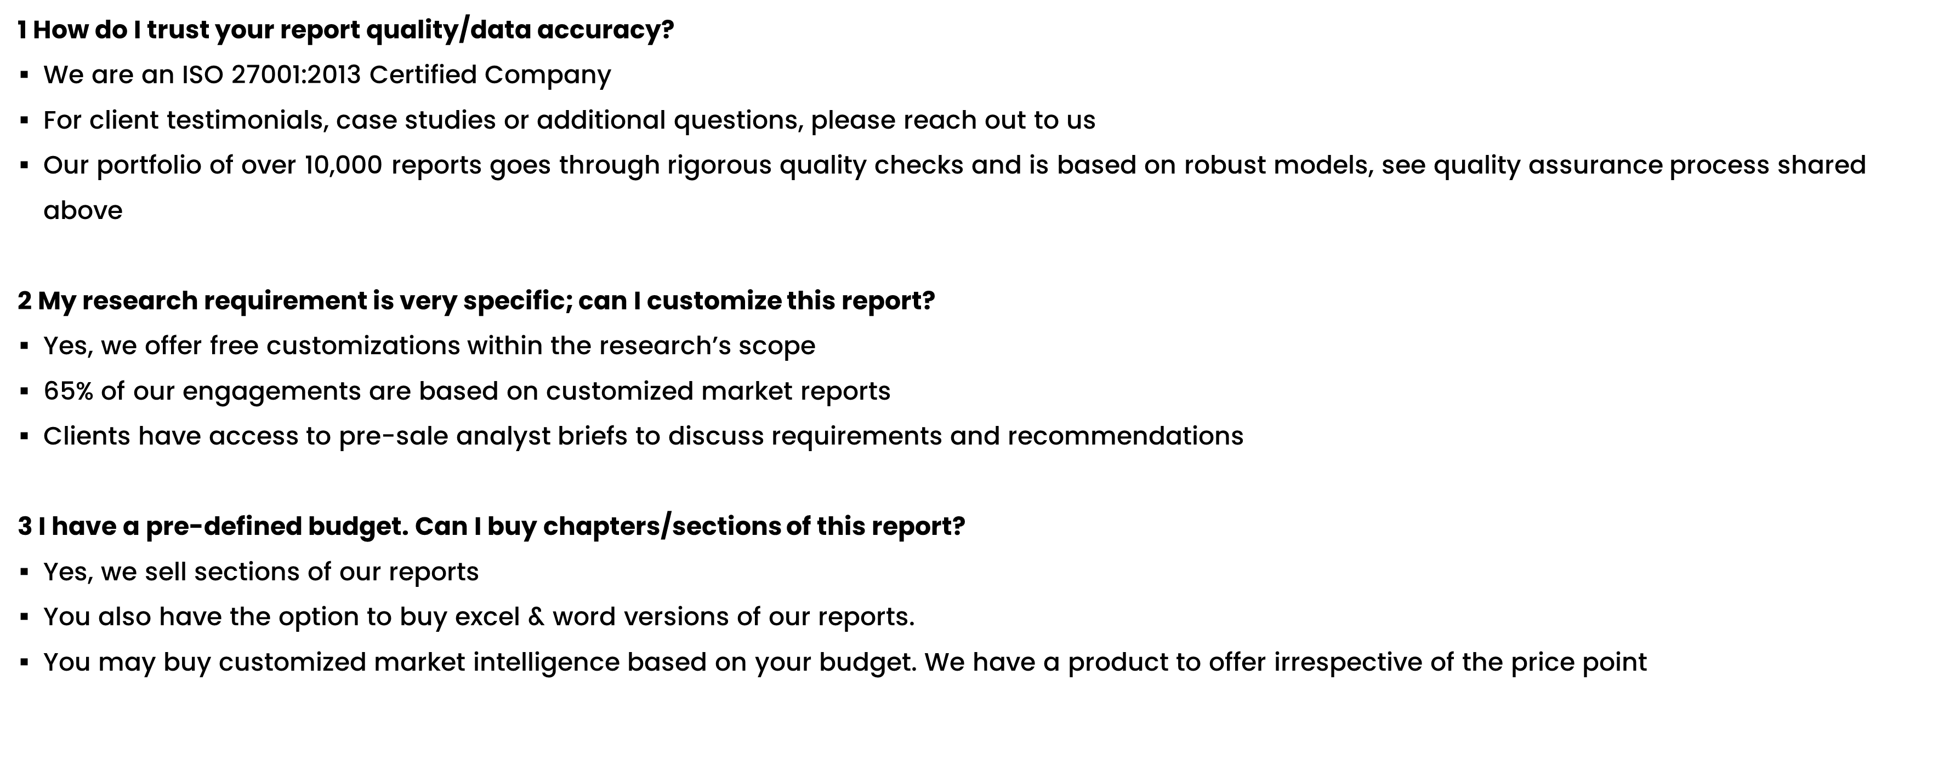
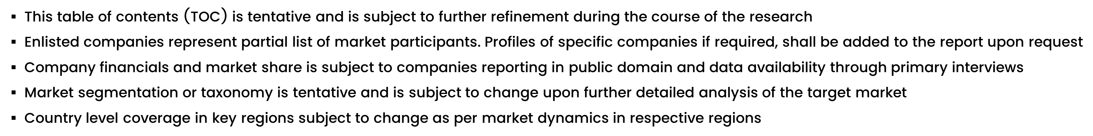
FAQs
NOTE

Slide 41






DISCLAIMER
SkyQuest provides strategic analysis to a select group of customers in response to orders. Our customers acknowledge when ordering that these strategic analysis for internal use and not for general publication or disclosure to any third party. SkyQuest does not endorse any vendor, product, or product type profiled in its publications. SkyQuest's strategic analysis constitutes estimations and projections based on secondary and primary research and are therefore subject to variations.
SkyQuest disclaims all warranties, expressed or implied, with respect to this research, including any warranties of merchantability or fitness, for any particular purpose. SkyQuest takes no responsibility for incorrect information supplied to it by manufacturers or users.
Trademarks, copyrights, and other forms of intellectual property belong to SkyQuest's respective owners and are protected by law. under no circumstance may any of these be reproduced, copied, or circulated in any form, without the prior written approval of SkyQuest's owner-as the case may be no part of this strategic analysis may be given, lent, resold, or disclosed to any third party, without express permission from SkyQuest team.
Reproduction and/or transmission in any form and by any means, including photocopying, mechanical, electronic, recording, or otherwise, without the permission of SkyQuest, is prohibited.
HEADQUARTERS
1 Apache Way, Westford, Massachusetts 01886, United States
APAC OFFICE
Room A & B, 2nd Floor, Lee Kee Commercial Building, 221-227, Queen’s Road Central, Hong Kong
GLOBAL DELIVERY CENTER
D-1001-1005, Swati Clover, Shilaj Circle, Sardar Patel Ring Rd, Thaltej, Ahmedabad, Gujrat-380054
WE ARE REACHABLE AT :-
info@skyquestt.com
+1-617-230-0741
www.skyquestt.com

Slide 42
THANK YOU
www.skyquestt.com

